Slide 1
FutureGrid and US Cyberinfrastructure Collaboration with EU
Symposium on transatlantic EU-U.S. cooperation in the field of large scale research infrastructures
1st October 2010 CNR, Rome, Italy
Geoffrey Fox
gcf@indiana.edu
http://www.infomall.org http://www.futuregrid.org
Director, Digital Science Center, Pervasive Technology Institute
Associate Dean for Research and Graduate Studies, School of Informatics and Computing
Indiana University Bloomington

Slide 2
US Cyberinfrastructure Context
There are a rich set of facilities
Production TeraGrid facilities with distributed and shared memory
Experimental “Track 2D” Awards
FutureGrid: Distributed Systems experiments cf. Grid5000
Keeneland: Powerful GPU Cluster
Gordon: Large (distributed) Shared memory system with SSD aimed at data analysis/visualization
Open Science Grid aimed at High Throughput computing and strong campus bridging

Slide 3
FutureGrid key Concepts I
FutureGrid is an international testbed modeled on Grid5000
Rather than loading images onto VM’s, FutureGrid supports Cloud, Grid and Parallel computing environments by dynamically provisioning software as needed onto “bare-metal” using Moab/xCAT
Image library for MPI, OpenMP, Hadoop, Dryad, gLite, Unicore, Globus, Xen, ScaleMP (distributed Shared Memory), Nimbus, Eucalyptus, OpenNebula, KVM, Windows …..
The FutureGrid testbed provides to its users:
A flexible development and testing platform for middleware and application users looking at interoperability, functionality and performance
Each use of FutureGrid is an experiment that is reproducible
A rich education and teaching platform for advanced cyberinfrastructure classes
Growth comes from users depositing novel images in library

Slide 4
Dynamic Provisioning Results
Time minutes
Number of nodes
Time elapsed between requesting a job and the jobs reported start time on the provisioned node. The numbers here are an average of 2 sets of experiments.

Slide 5
FutureGrid key Concepts II
Support Computer Science and Computational Science
Industry and Academia
Europe and USA
FutureGrid has ~5000 distributed cores with a dedicated network and a Spirent XGEM network fault and delay generator
Key early user oriented milestones:
June 2010 Initial users
November 2010-September 2011 Increasing number of users allocated by FutureGrid
October 2011 FutureGrid allocatable via TeraGrid process
3 classes using FutureGrid this fall
Apply now to use FutureGrid on web site www.futuregrid.org

Slide 6
FutureGrid Partners
Indiana University (Architecture, core software, Support)
Collaboration between research and infrastructure groups
Purdue University (HTC Hardware)
San Diego Supercomputer Center at University of California San Diego (INCA, Monitoring)
University of Chicago/Argonne National Labs (Nimbus)
University of Florida (ViNE, Education and Outreach)
University of Southern California Information Sciences (Pegasus to manage experiments)
University of Tennessee Knoxville (Benchmarking)
University of Texas at Austin/Texas Advanced Computing Center (Portal)
University of Virginia (OGF, Advisory Board and allocation)
Center for Information Services and GWT-TUD from Technische Universtität Dresden. (VAMPIR) EUROPE!
Red institutions have FutureGrid hardware

Slide 7
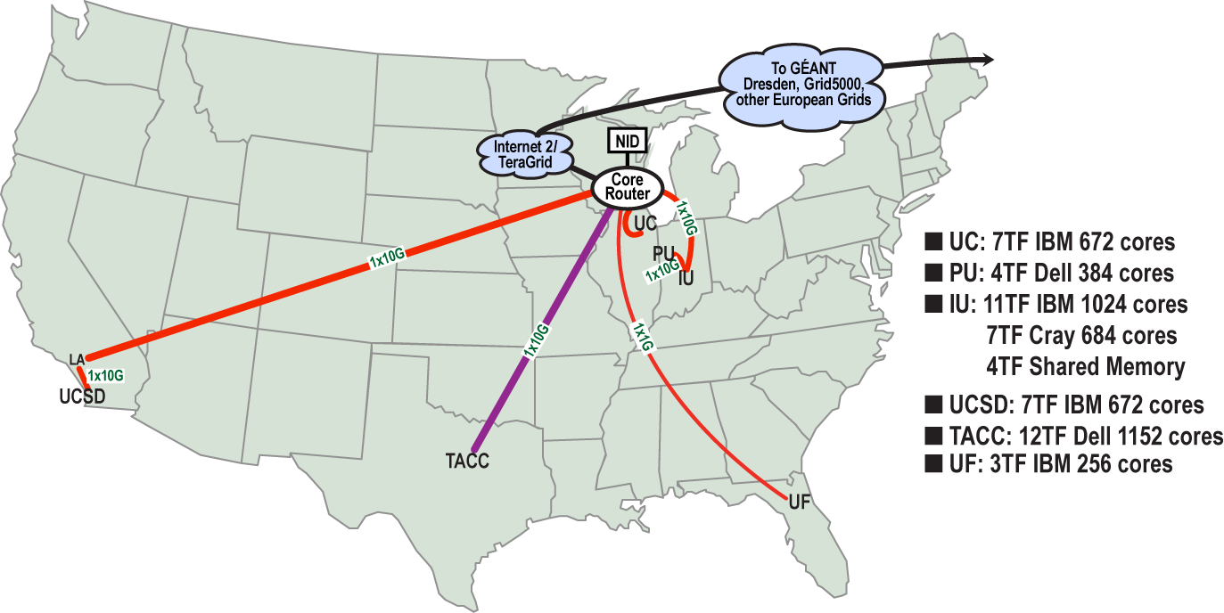
FutureGrid: a Grid/Cloud/HPC Testbed
Operational: IU Cray operational; IU , UCSD, UF & UC IBM iDataPlex operational
Network, NID operational
TACC Dell finished acceptance tests
INCA Node Operating Mode Statistics
NID: Network Impairment Device
Private Public
FG Network

Slide 8
Grid Interoperability from Andrew Grimshaw
Colleagues,
FutureGrid has as two of its many goals the creation of a Grid middleware testing and interoperability testbed as well as the maintenance of standards compliant endpoints against which experiments can be executed. We at the University of Virginia are tasked with bringing up three stacks as well as maintaining standard-endpoints against which these experiments can be run.
We currently have UNICORE 6 and Genesis II endpoints functioning on X-Ray (a Cray). Over the next few weeks we expect to bring two additional resources, India and Sierra (essentially Linux clusters), on-line in a similar manner (Genesis II is already up on Sierra). As called for in the FutureGrid program execution plan, once those two stacks are operational we will begin to work on g-lite (with help we may be able to accelerate that). Other standards-compliant endpoints are welcome in the future , but not part of the current funding plan.
I’m writing the PGI and GIN working groups to see if there is interest in using these resources (endpoints) as a part of either the GIN or PGI work, in particular in demonstrations or projects for OGF in October or SC in November. One of the key differences between these endpoints and others is that they can be expected to persist. These resources will not go away when a demo is done. They will be there as a testbed for future application and middleware development (e.g., a metascheduler that works across g-lite and Unicore 6).
We RENKEI/NAREGI project are interested in the participation for interoperation demonstrations or projects for OGF and SC. We have a prototype middleware which can submit and receive jobs using the HPCBP specification. Can we have more detailed information of your endpoints(authentication, data staging method, and so on) and the participation conditions of the demonstrations/projects.

Slide 9
OGF’10 Demo
SDSC
Rennes
Grid’5000 firewall
UF
Lille
UC
Sophia
ViNe provided the necessary inter-cloud connectivity to deploy CloudBLAST across 5 Nimbus sites, with a mix of public and private subnets.

Slide 10
Education on FutureGrid
Build up tutorials on supported software
Support development of curricula requiring privileges and systems destruction capabilities that are hard to grant on conventional TeraGrid
Offer suite of appliances (customized VM based images) supporting online laboratories
Supporting ~200 students in Virtual Summer School on “Big Data” July 26-30 with set of certified images – first offering of FutureGrid 101 Class; TeraGrid ‘10 “Cloud technologies, data-intensive science and the TG”; CloudCom conference tutorials Nov 30-Dec 3 2010
Experimental class use fall semester at Indiana, Florida and LSU

Slide 11
Interactions with Europe I
Software Collaboration: currently Amazon/Azure far ahead of academic computing platforms
Collaboration between Venus-C(?), FutureGrid and Magellan (DoE) on quantifying value of Clouds in Science
Have planning meeting at CloudCom 2010
Collaboration between NSF Keeneland facility and PRACE (?) on quantifying value of GPGPU’s in Science and developing programming models for Heterogeneous/GPGPU systems
Collaboration between NSF Gordon facility and others on quantifying infrastructure needed for data intensive computational science and engineering

Slide 12
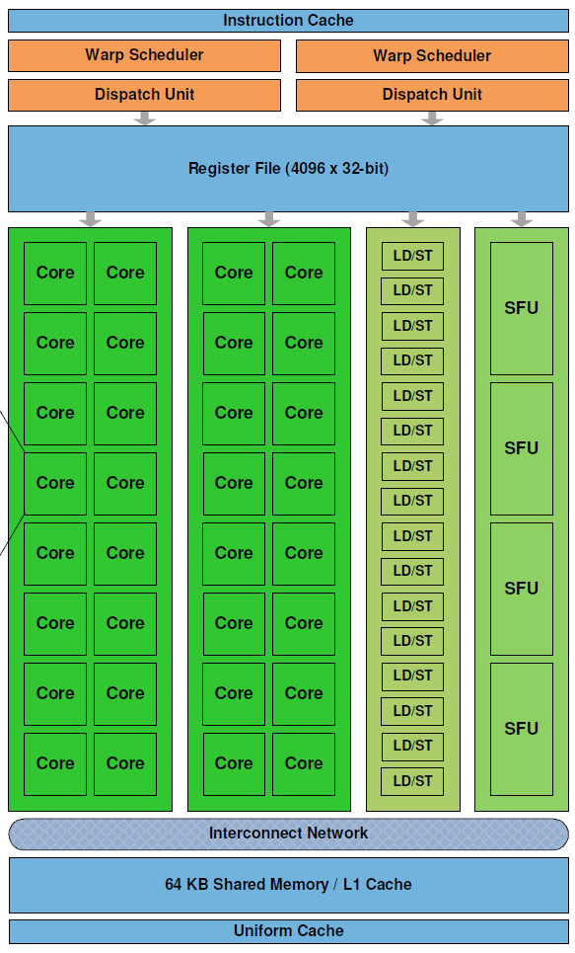
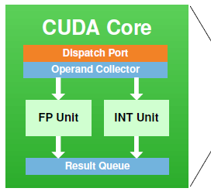
Keeneland – NSF-Funded Partnership to Enable Large-scale Computational Science on Heterogeneous Architectures
NSF Track 2D System of Innovative Design
Georgia Tech
UTK NICS
ORNL
UTK
Two GPU clusters
Initial delivery
Being built now; Expected availability is November 2010
Full scale – Spring 2012
NVIDIA, HP, Intel, Qlogic
Operations, user support
Education, Outreach, Training for scientists, students, industry
Software tools, application development
Exploit graphics processors to provide extreme performance and energy efficiency
Prof. Jeffrey S. Vetter
Prof. Richard Fujimoto
Prof. Karsten Schwan
Prof. Jack Dongarra
Dr. Thomas Schulthess
Prof. Sudha Yalamanchili
Jeremy Meredith
Dr. Philip Roth
Richard Glassbrook
Patricia Kovatch
Stephen McNally
Dr. Bruce Loftis
Jim Ferguson
James Rogers
Kathlyn Boudwin
Arlene Washington
Many others…
NVIDIA’s new Fermi GPU
http://keeneland.gatech.edu
http://ft.ornl.gov

Slide 13
Interactions with Europe II
Joint Summer Schools in areas of Computational and Data-enabled Science and Engineering – GPU’s, Petascale, Big Data, Clouds
Define “appliances” to support laboratories
Study link US Cyberinfrastructure to EGI starting with setting up an “EGI node” on FutureGrid
Build on work of GIN group in OGF
Suite of Interoperability experiments between Grids and Clouds – US Europe Asia South America
Studies of importance of GreenIT using Grid5000, FutureGrid and ?
Generalize to other distributed computing research

Slide 14
194 papers submitted to main track; 48 accepted; 4 days of tutorials including OpenNebula

